Slide 1
Term Project - CS313E
By Utsav Nimavat and Siena Theivagt

Slide 2
Project goals
We are both Informatics majors with a focus in human-centered data science
Wanted to design a project revolving around loading in data, sorting it, and visualizing it
Decided to focus our project on web-scraping data from the internet, cleaning it, sorting and printing without outside libraries, and graphing relationships in our data

Slide 3

Overview
Our project revolves around hurricane data we web-scraped from wikipedia.
Web-scraped the data with the BeautifulSoup and Requests API.
Cleaned the data using Pandas Dataframes.
Utilized binary search trees to build a program capable of sorting the data by column values with no external libraries.
Graphed the data with Seaborn library to show relationships between values.

Slide 4
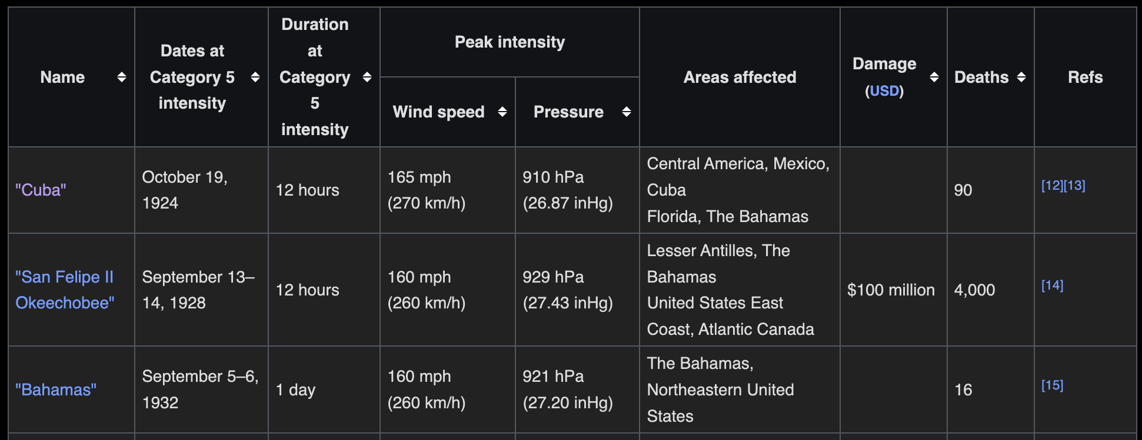
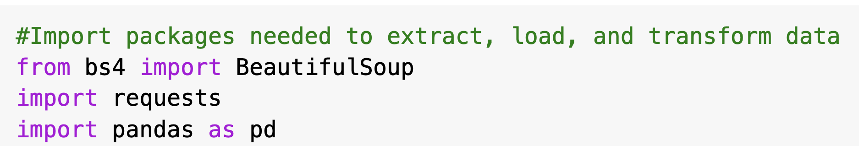
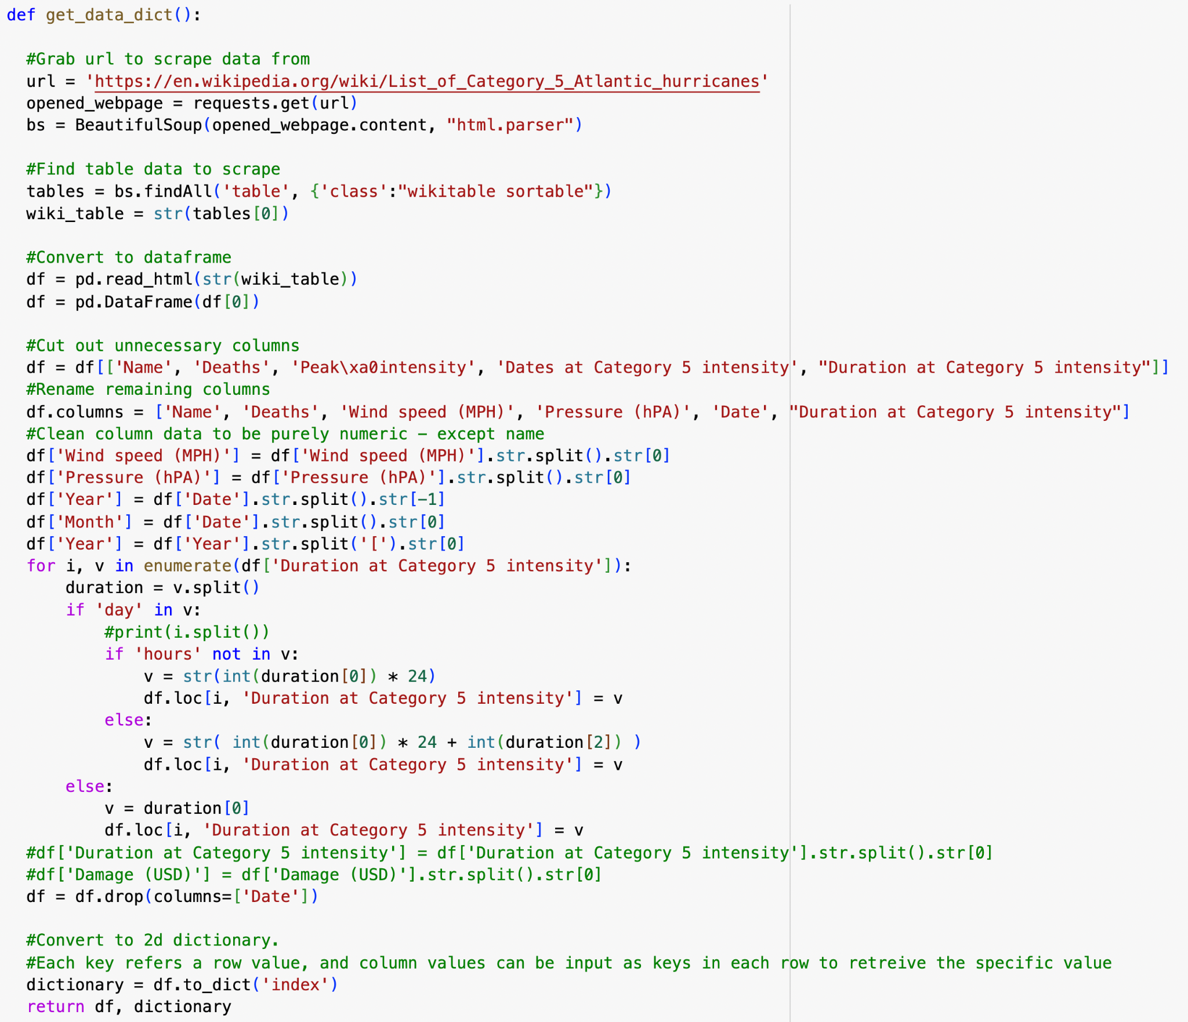
Retrieving the data - web-scraping
Function called get_data_dict() was created to web-scrape the data, clean it, and return the dataframe & a 2D-dictionary made from it
Requests API grabs HTML of site if allowed
BeautifulSoup parses the html and grabs our table
Pandas converts the table HTML into a dataframe
Notes:
To start our project, we created a function called get_data_dict() that web-scraped our wikipedia hurricane data and loaded it into a Pandas Dataframe, which is a data structure used for storing tabular data. Then, we cleaned up the data using Pandas, and returned both the cleaned dataframe for graphing, and a 2d dictionary created from it for sorting.
To web-scrape the data, we used two libraries - Requests, and BeautifulSoup. The Requests API allows us to interact with websites and “request” to scrape it’s data, returning a status code indicating whether the request was successful and the content of the page if so. Wikipedia does allow web-scraping, so we used Requests to grab the data inside. Next, we used BeautifulSoup, a popular API for parsing structured data. We accessed the content of the data grabbed by Requests using BeautifulSoup’s HTML parser, and searched for all tables within our scraped HTML that fit our criteria. In turn, BeautifulSoup returned a list of HTML tables stored from our scraped data.
On the Wikipedia page for Category 5 Hurricanes, the first table is the one we wanted to grab, so we selected it and within the list of scraped tables and used Pandas to read the HTML and convert it into a DataFrame. Now, we had the raw data from the Wikipedia page stored in our notebook, and it was time to clean it up.

Slide 5
Retrieving the data - cleaning
Function called get_data_dict() was created to web-scrape the data, clean it, and return the dataframe & a 2D-dictionary made from it
Removed unwanted columns from dataframe
Cleaned numerical columns to only include integer units
Return dataframe for graphing, and 2d-dictionary for our sorting functions
Notes:
Within our table, the column we wanted to keep were Name, Deaths, Wind Speed, Pressure, Year, Month, and Duration at Category 5 intensity. Most of these columns, spare for Name and Month, held quantitative data to sort by and analyze with graphs, which is why we chose them. Most qualitative columns simply had their units removed and stored as just numbers, but a few required extra conversion. Wind Speed and Pressure were subcolumns of a larger column called Peak Intensity, so we had to split those up. There was no Year and Month column in the original data, just a Date Column, so we spun the Year and Month columns off it and deleted the date column. The Duration column was the most challenging, as it stored duration in either hours, days, or hours and days. We decided to convert it all into hours, which required looping through the data and checking if days existed, and if so, multiplying them by 24 to get hours.
Like I mentioned before, the get_data_dict() function returns both this cleaned dataframe, and a 2d dictionary. Dataframes are a popular structure for holding tabular data, and the libraries we used to visualize our data had built-in support for them, which is why they were returned. We also converted the dataframe into a 2d dictionary and returned that too. The keys in each dictionary corresponded to a row value starting from 0, with the subkeys corresponding to a column name that would return the exact data point for the specified dictionary key containing the row and subkey containing the column.
Once we had both of these data structures, it was time to move on to the heart of our program, where we would sort our data.

Slide 6
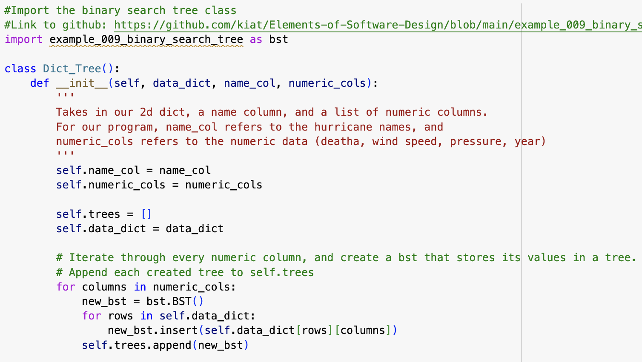
Sorting our data
Created a class called Dict_Tree that builds upon Prof. Teymourian’s BST implementation
Takes in our 2d dictionary, one ‘name’ column, and a list of qualitative columns to sort by
Builds a BST for every qualitative column, storing its values in each tree
Notes:
We created a new class called Dict_Tree that was based off the Binary Search Tree data structure we learned in class. The purpose of this class was to take in a 2d-dictionary, it’s designated “qualitative column”, and a list of quantitative columns to sort the dictionary by. For each quantitative column, a new BST would be created with its values, stored in a list of trees within our class. By using a BST, the values inside each column would be easily sorted as each tree was constructed, and using the proper traversal methods, one could easily access the data within in sorted fashion.

Slide 7
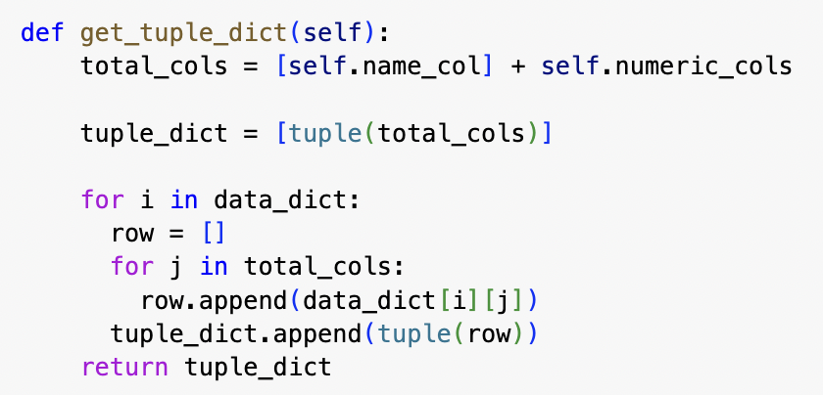
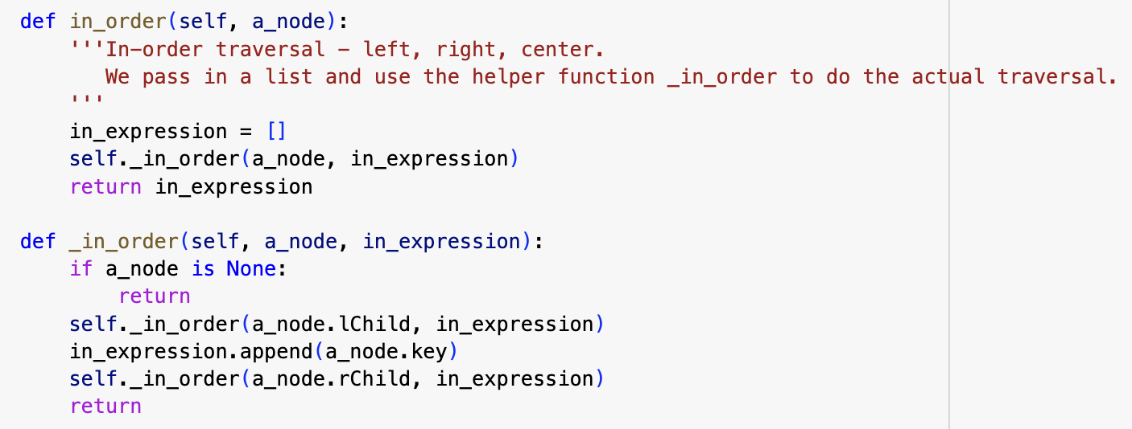
Sorting our data - helper methods
get_tuple_dict() converts our given 2d dictionary into a list of tuples.
in_order() - recursive function that performs in-order traversal on a given BST and returns a list of values.
The heart of our sorting function
Notes:
Using the function get_tuple_dict, we also converted the given 2d dictionary and its specified columns into a list of tuples, as dictionaries (and hashmaps in general) are not built around sorting data, but rather accessing them quickly. The first row in this list of tuples would be the header with the names of all the columns, with each following row corresponding to a row of data, resembling a table.
In-order traversal was also utilized as our way of grabbing the data within each BST. Using a recursive method we returned in class, the in_order function would take the root node of any given tree and return a list of sorted values in ascending order. This is the heart of our sorting function, as it is the way we grab the data from the trees in a sorted manner.

Slide 8
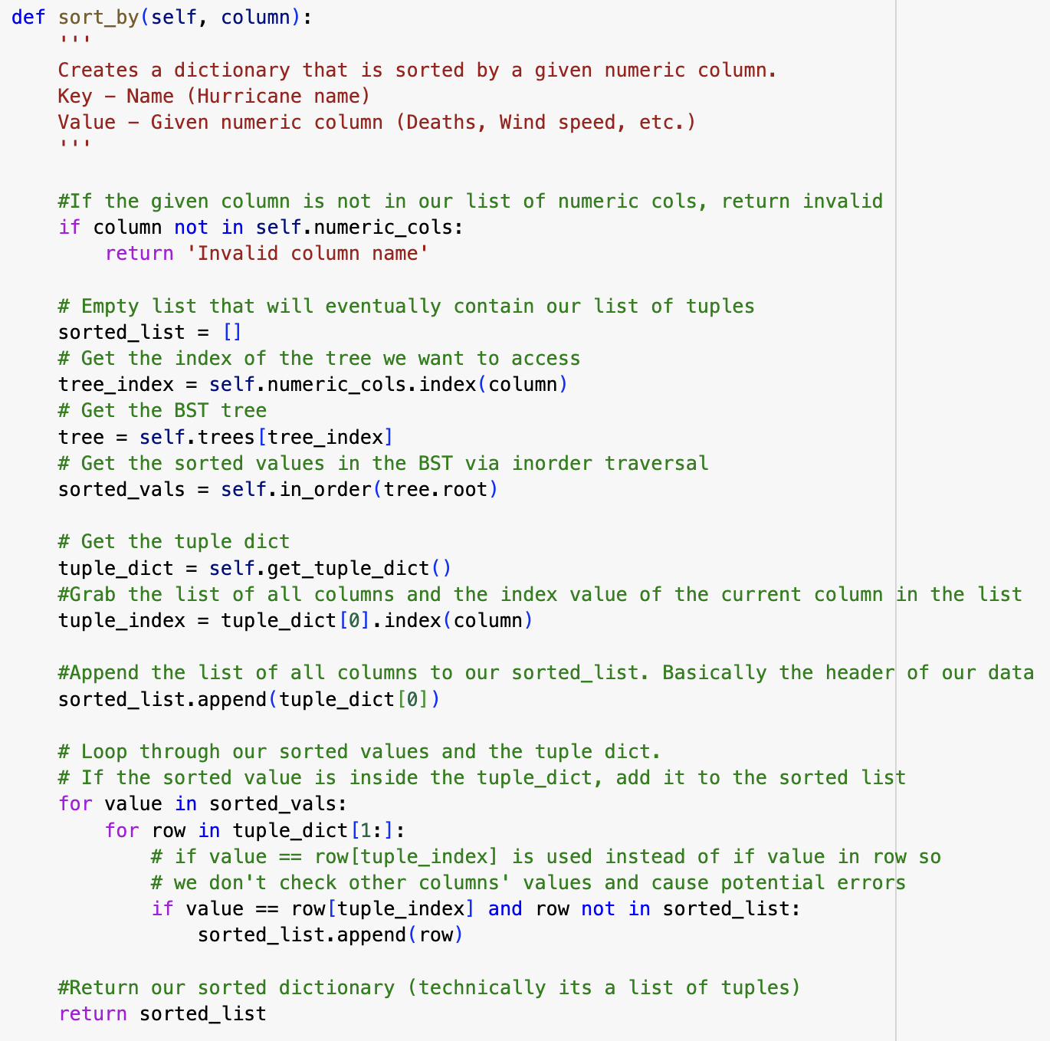
Sorting our data - sorting functions
sort_by() takes in a quanitative column and returns a list of tuples sorted in ascending order
Grabs list of sorted values in given column by performing inorder traversal on its corresponding BST
Creates sorted list of tuples by comparing our unsorted one to our sorted list of values
Notes:
Finally, we have our actual sorting function. sort_by() takes in a quantitative column, and sorts the 2d dictionary as a sorted list of tuples. First, our program checks to ensure the column the user is requesting to sort by is a valid column name, and if not, an error message is returned. Since most of our program is about following a set of steps to achieve a goal, there isn’t much in the way for user input controlling the program. However, this function allows anyone looking at the program to sort our web-scraped data by a quantitative category of their choosing, and is as far as our test-cases and error-handling go.
Assuming user input is given correctly, the function begins attempting the sort. First, an empty list is created that will eventually contain rows of tuples with our sorted data. Next, we grab the index of binary-tree inside our tree list that contains the values corresponding to the user-inputted column. Using in-order traversal, we grab the sorted values within the tree and store them in a list called sorted_vals, which contains the values of the user-inputted column in ascending order. Now that we have the sorted values, it’s time to built the rest of the table.
We use our helper function get_tuple_dict() to convert our 2d dictionary into an unsorted list of tuples of the data, and loop through both our list of sorted values and this dictionary to see where the data matches. If there is a row within the tuple list that contains the sorted value at the specified column, we append that row to a list called sorted_list. This way, we slowly build our sorted list of tuples, and eventually return the sorted list.

Slide 9
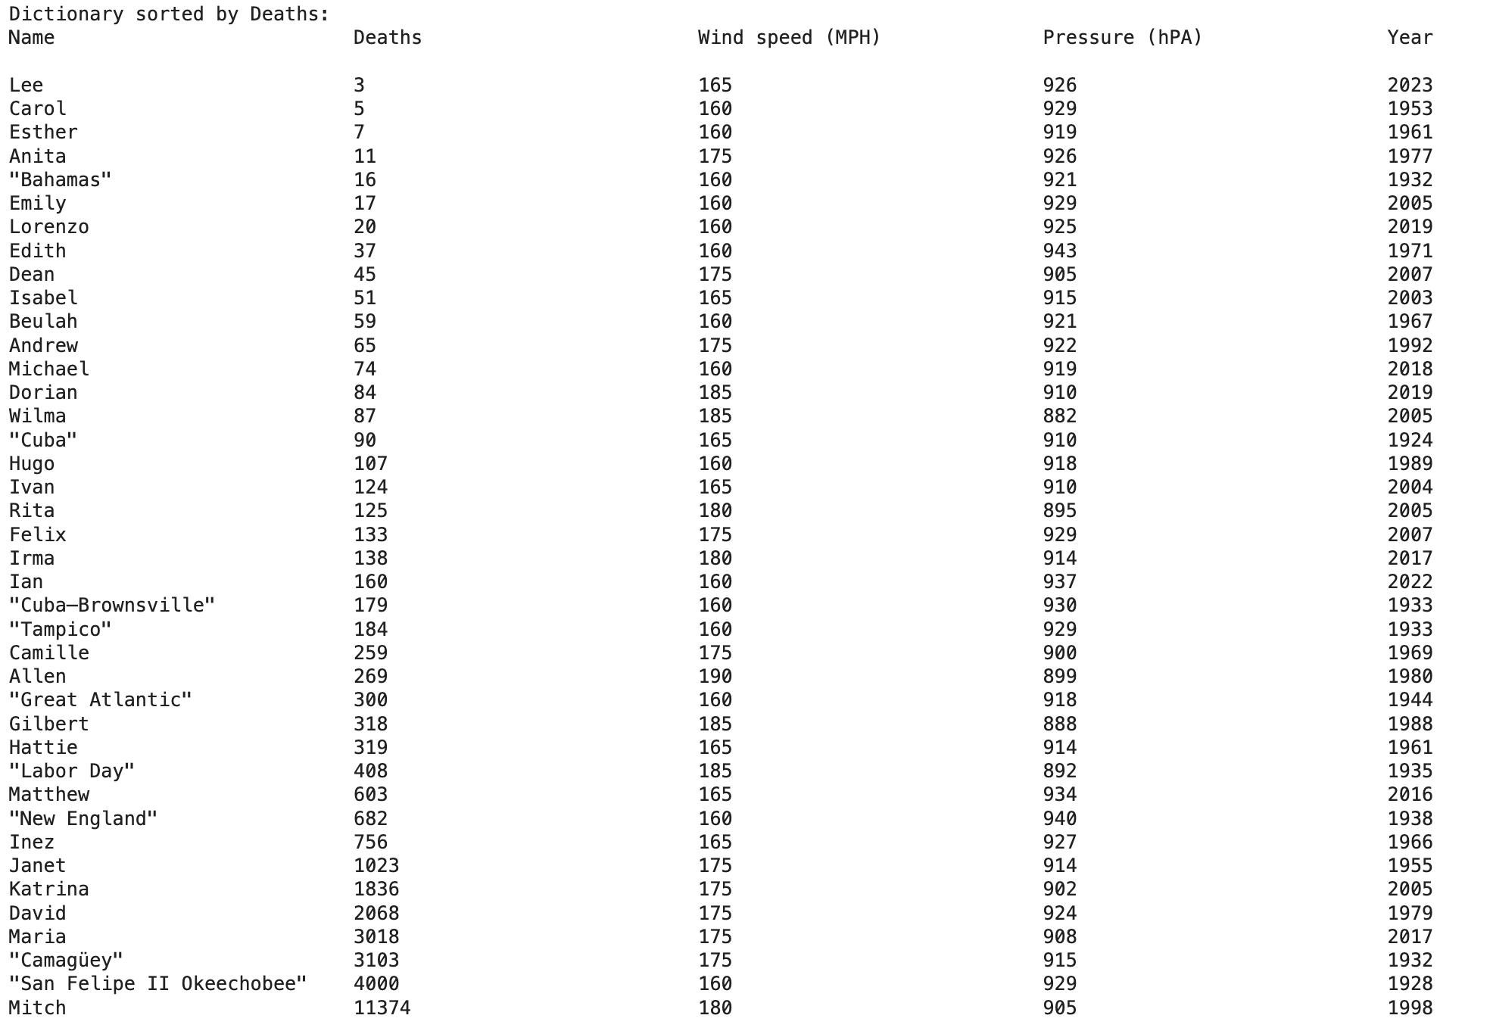
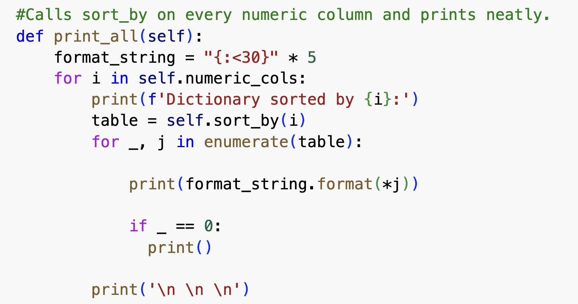
Sorting our data - outputting the data
print_all() calls sort_by() on every quantitative column and neatly prints out all the outputted lists
Notes:
As a way of neatly outputting our data, we designed a function called print_all(). This function calls our previous sort_by() function on every quantitative column given, and neatly outputs each sorted tuple list using string formatting in a clean, neat fashion that resembles tables inside excel or pandas. Here is one of the tables returned, showing our web-scraped data of Category 5 Hurricanes sorted by deaths in ascending order. The program also outputs a sorted table for each other column given, such as Wind Speed, Pressure, and Year, but they’re not shown on these slides.

Slide 10
Data Visualizations

Slide 11
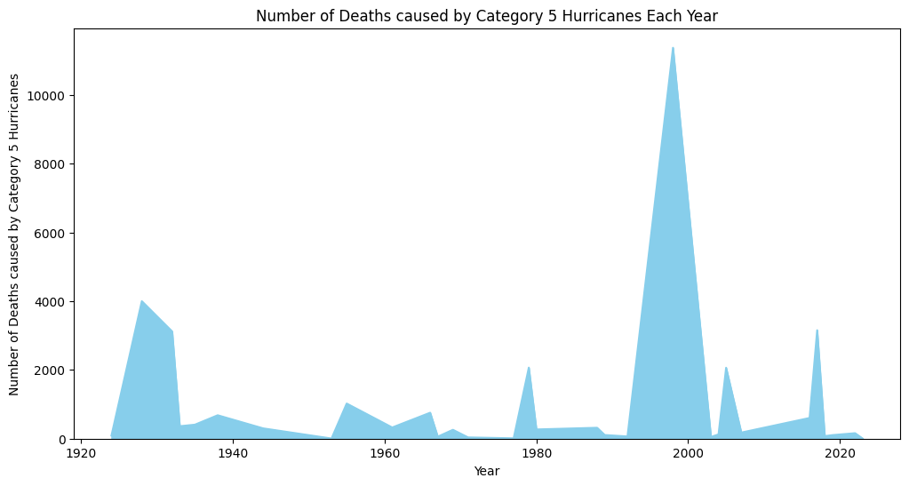
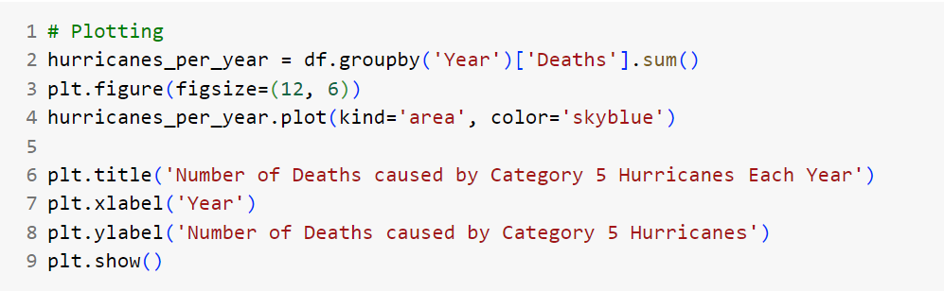
Line Graph
groupby() splits the data into groups
figure() creates the size of the figure
plot() is a method that plots the data frame on a graph.
title() creates a title
xlabel() creates a label for the x-axis
ylabel() creates a label for the y-axis

Slide 12
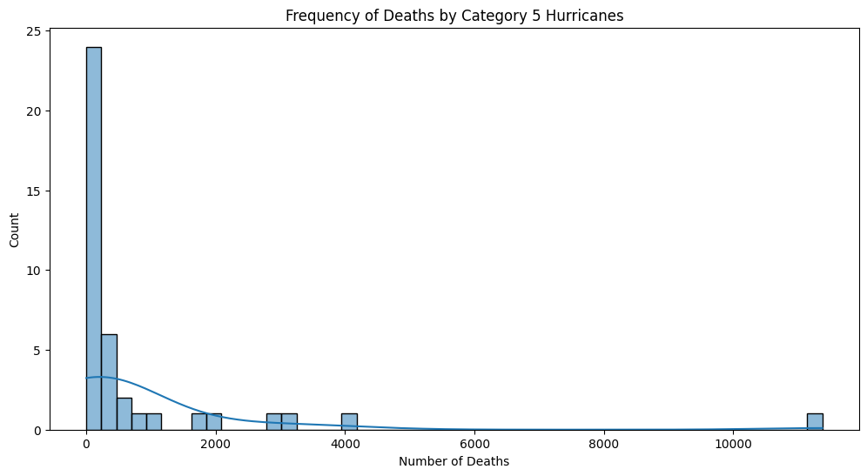
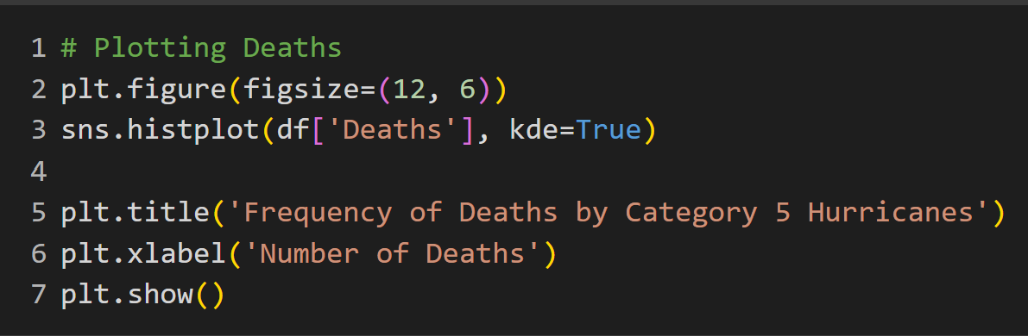
histplot() creates a histogram
show() prints the histogram
Notes:
seaborn.histplot — seaborn 0.13.0 documentation (pydata.org)

Slide 13
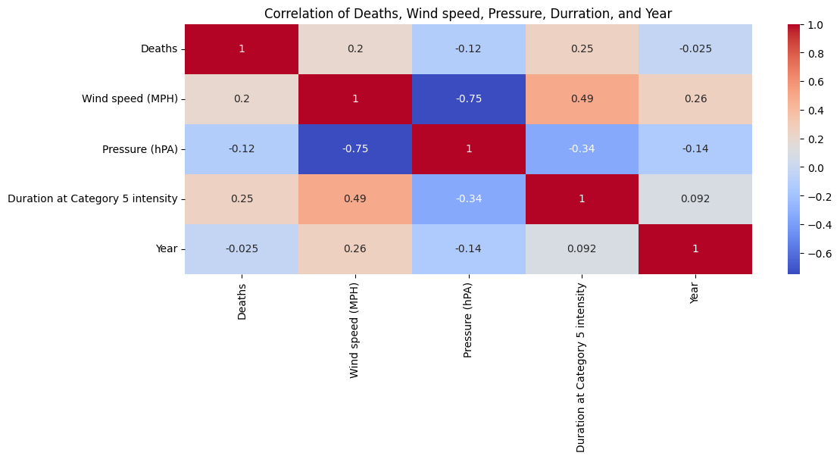
Strong negative correlation between Pressure and Wind speed
Strong correlation between Wind speed and Duration of hurricane
heatmap() creates a heatmap
corr() eliminates columns that will be of no use when generating a heatmap
df = df.apply(pd.to_numeric, errors='ignore')
plt.figure(figsize=(10, 6))
sns.heatmap(df.corr(), annot =True, cmap='coolwarm')
plt.tight_layout()
plt.title('Correlation of Deaths, Wind speed, Pressure, Durration, and Year')
plt.show()

Slide 14
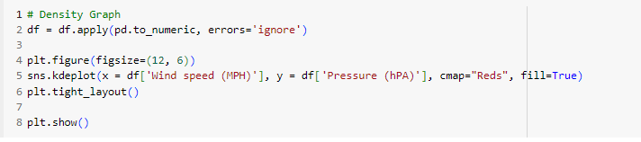
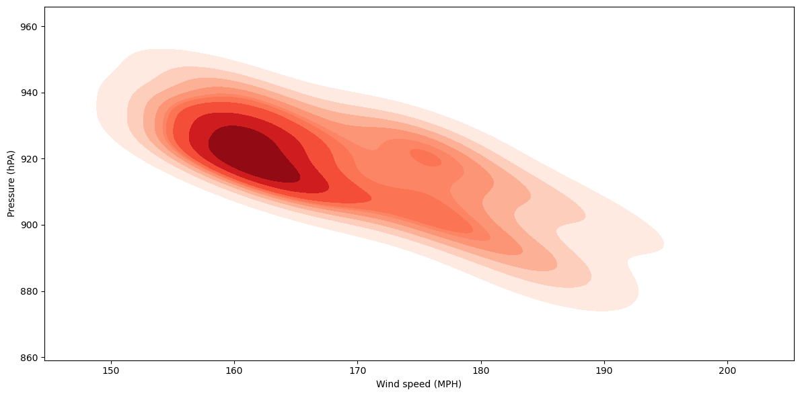
Density Graph
kdeplot() creates a density graph

Slide 15
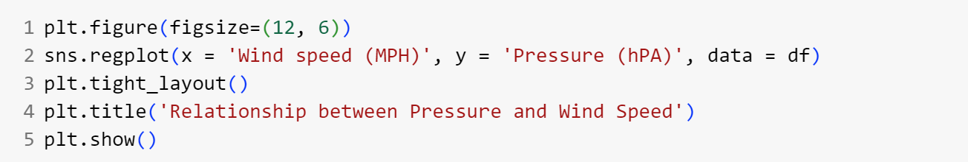
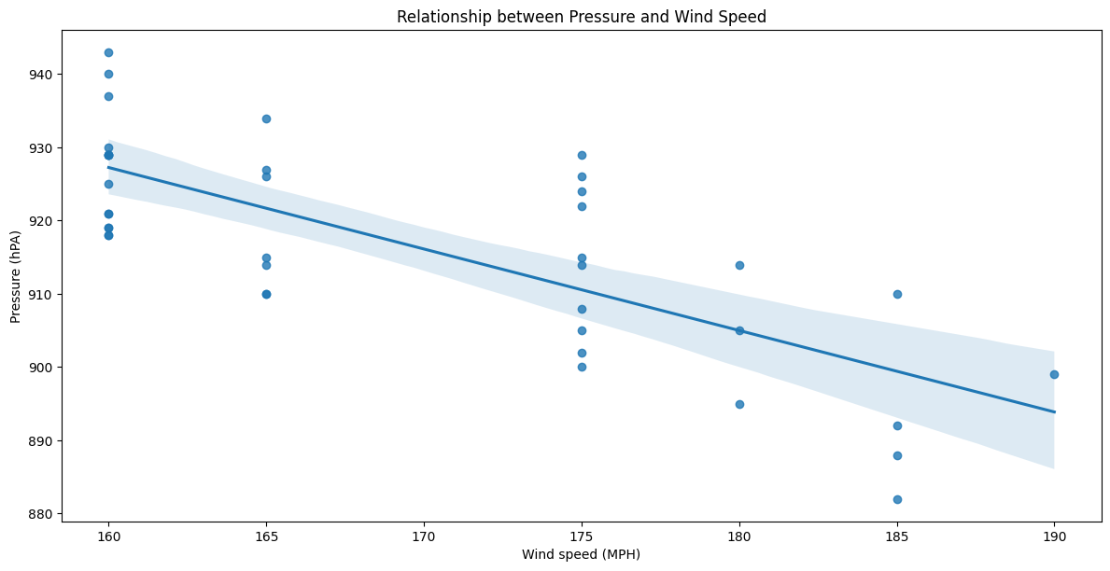
Regression
Plot
regplot() creates a regression plot

Slide 16
Room for improvement
We were unable to figure out how to properly webscrape the Damages per USD column with BeautifulSoup
Need to better understand how the libraries we use work
Although Binary Search Trees were utilized to efficiently sort the data, we used many for-loops to build our sorted data tables - making our program less efficient
If we had more data, we could create more interesting visualizations

Slide 17
Resources
Hunter, J., Dale, D., Firing, E., Droettboom, M., Matplotlib development team. (2023). Plot (x,y). Matplotlib. https://matplotlib.org/stable/plot_types/basic/plot.html#sphx-glr-plot-types-basic-plot-py
Waskom, M. (2023). Seaborn: Histplot. Seaborn. https://seaborn.pydata.org/generated/seaborn.histplot.html#seaborn.histpot
Waskom, M. (2023). Seaborn: Statistical data visualization. Seaborn.https://seaborn.pydata.org/index.html

Slide 18
FIN
Thank you for watching!

